Slide 1
Volve data Prophet Analysis
By Abhishek Pandey

Slide 2
WORK-FLOW
Input Data
Time Series Data (y, ds)
Data Preprocessing
Handle Missing Data
Outlier Detection
Transformations
Model Initialization
Define Seasonality
Set Growth Parameters
Output Results
Forecast Values
Plot Forecast
Forecasting
Make Predictions
Uncertainty Intervals
Model Fitting
Fit Model to Data
Estimate Parameters

Slide 3
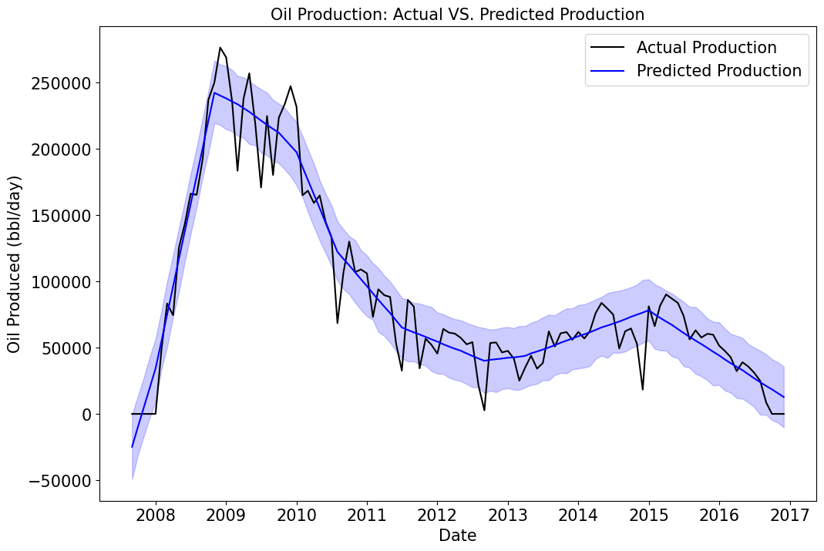
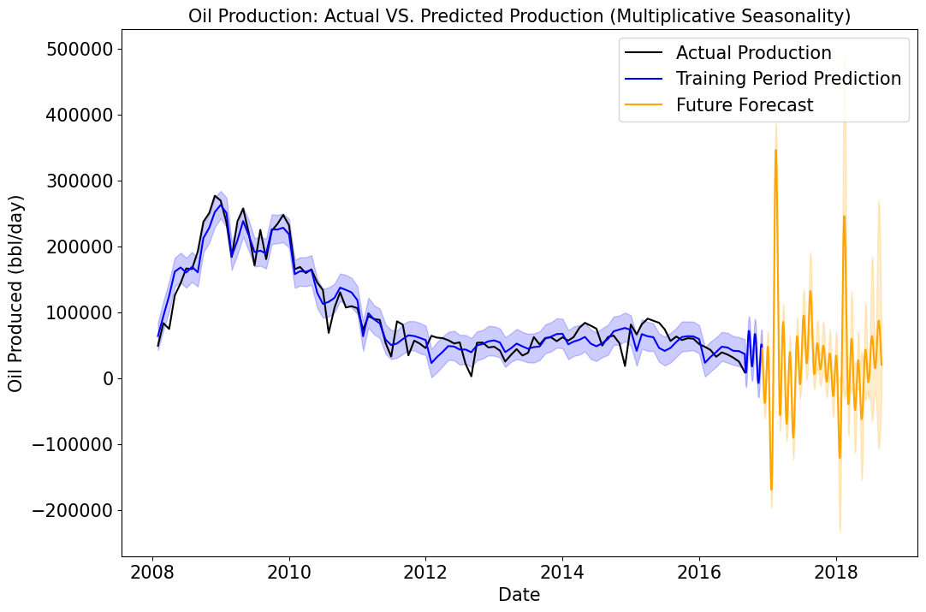
FIELD
Without Seasonality
With Seasonality

Slide 4
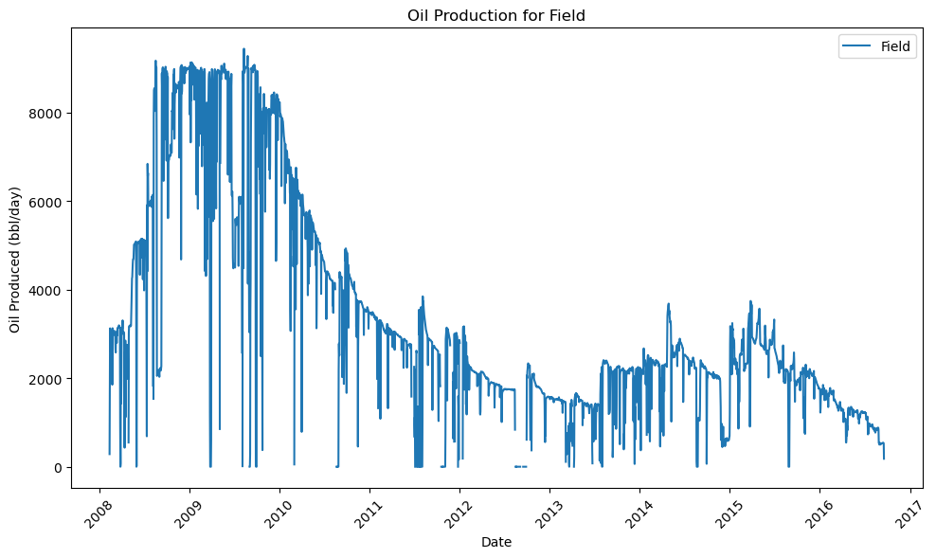
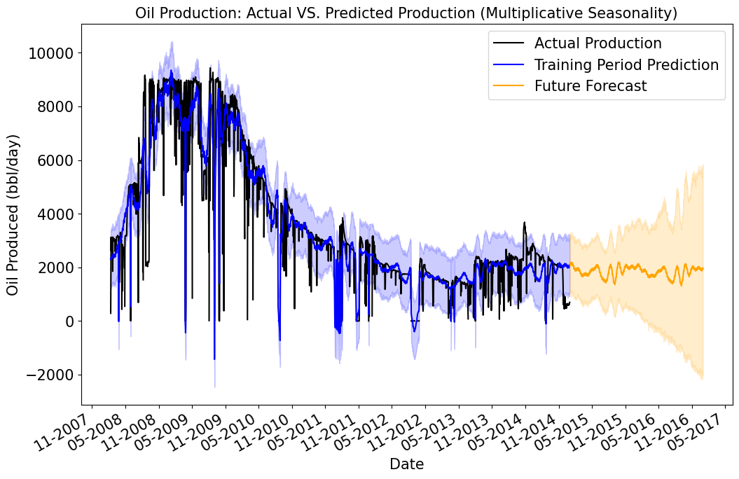
FIELD Available Data Comparison
Without data delete
With data delete

Slide 5
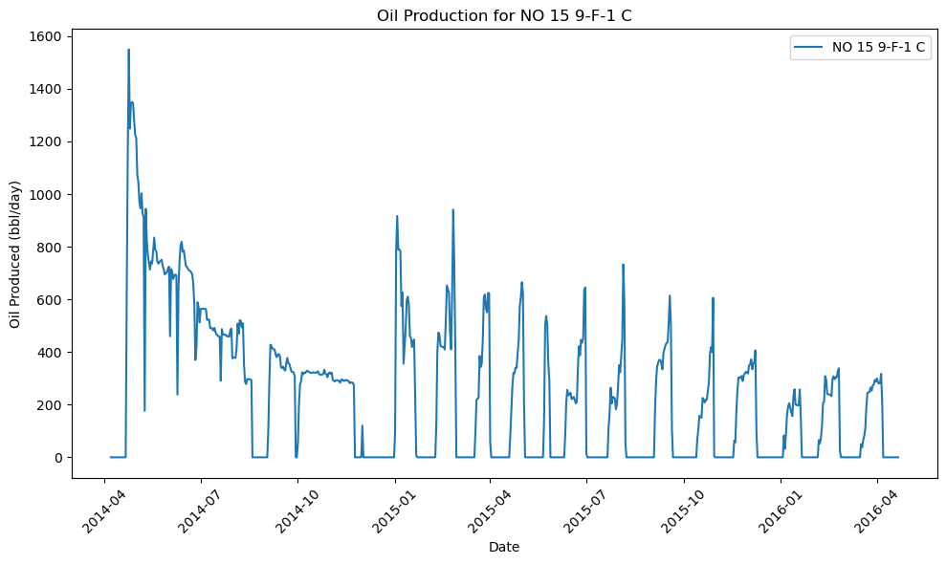
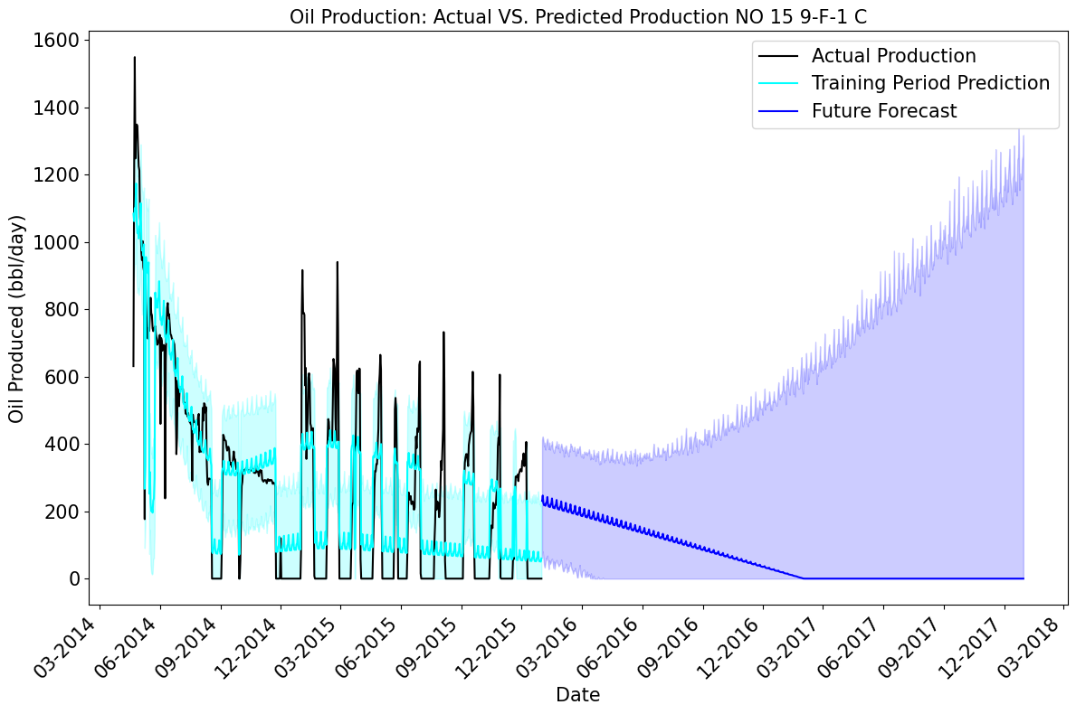
NO 15 9-F-1 C
Without data delete
With data delete

Slide 6
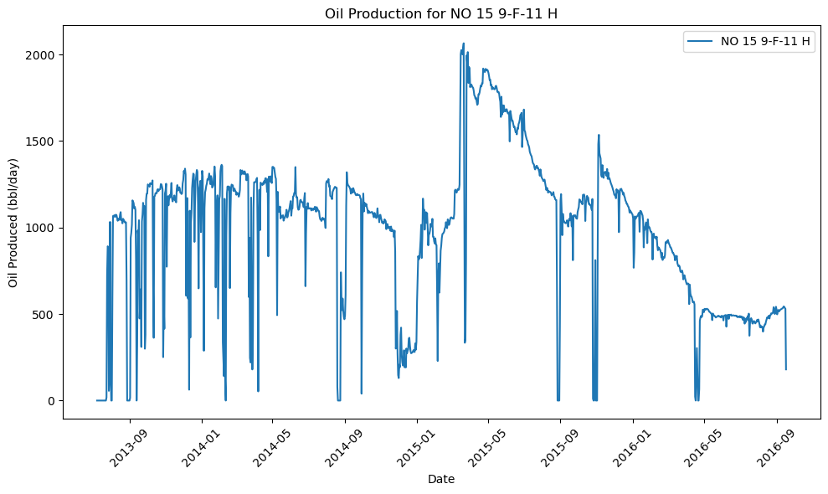
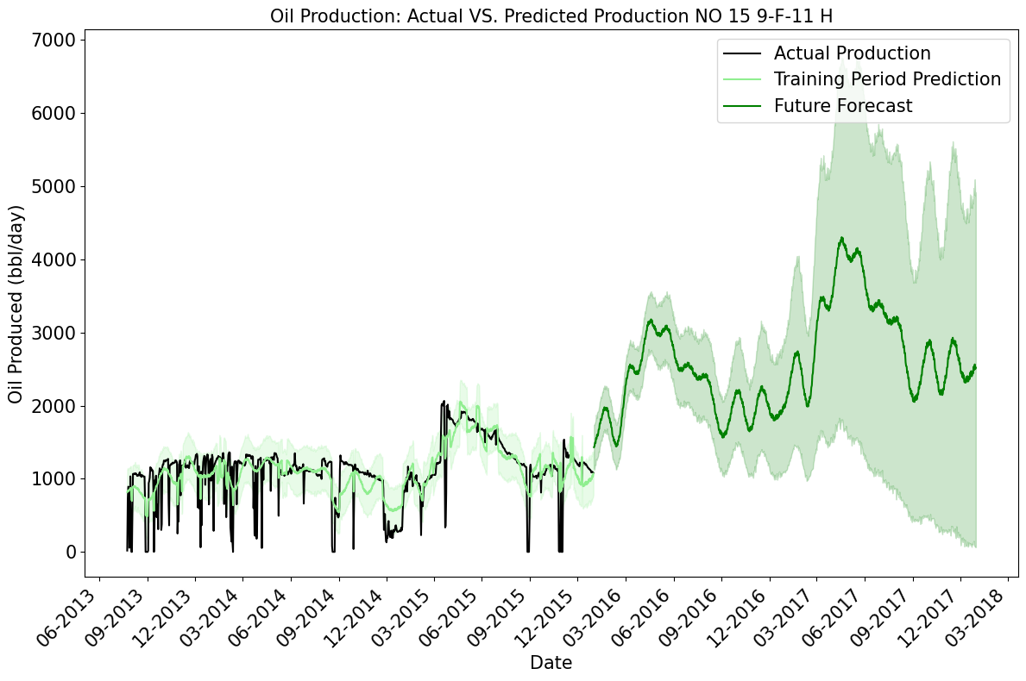
NO 15 9-F-11 H
Without data delete
With data delete

Slide 7
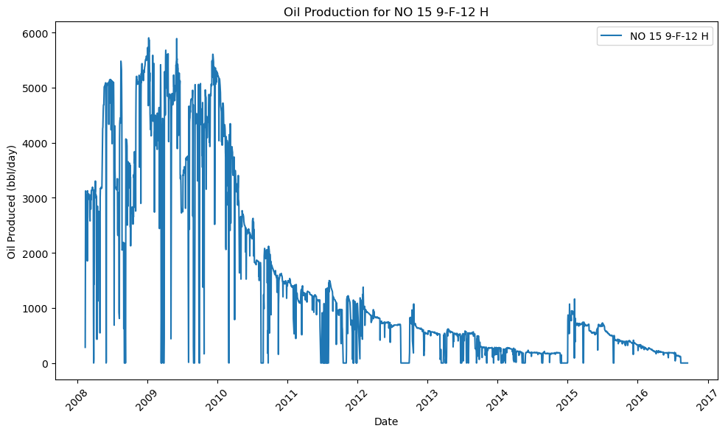
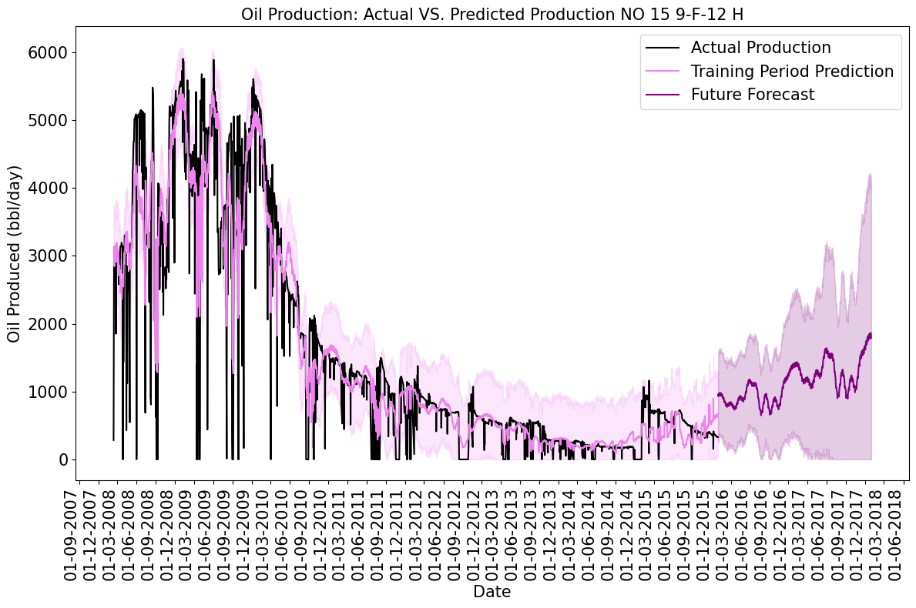
NO 15 9-F-12 H
Without data delete
With data delete

Slide 8
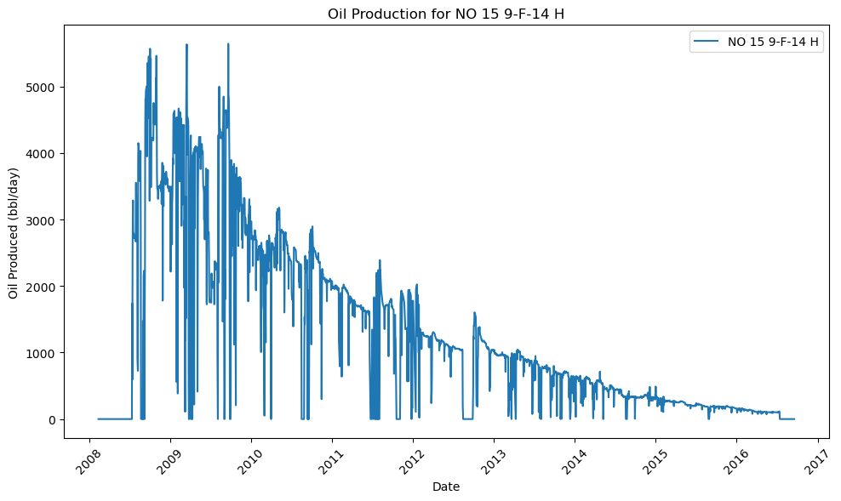
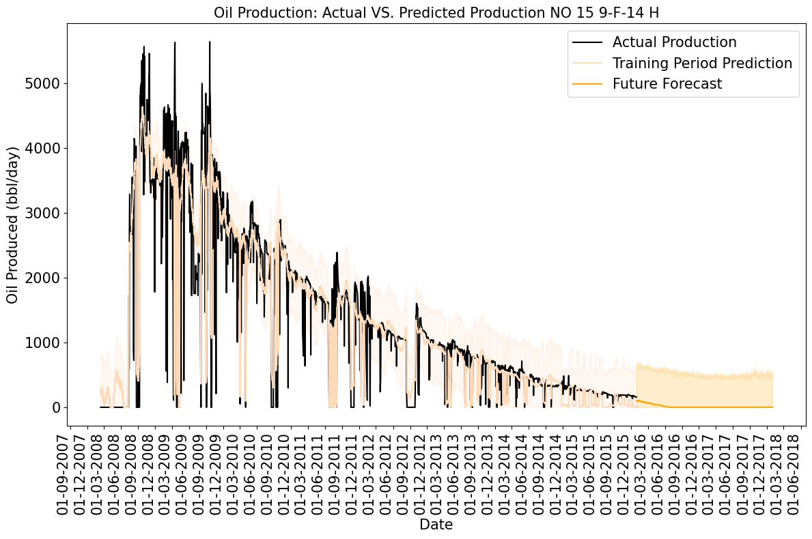
NO 15 9-F-14-H
Without data delete
With data delete

Slide 9
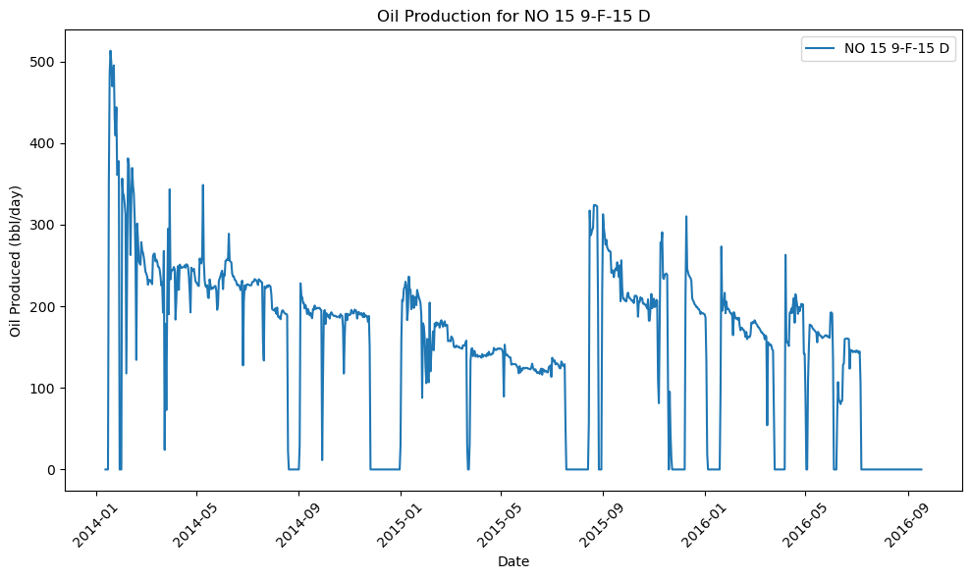
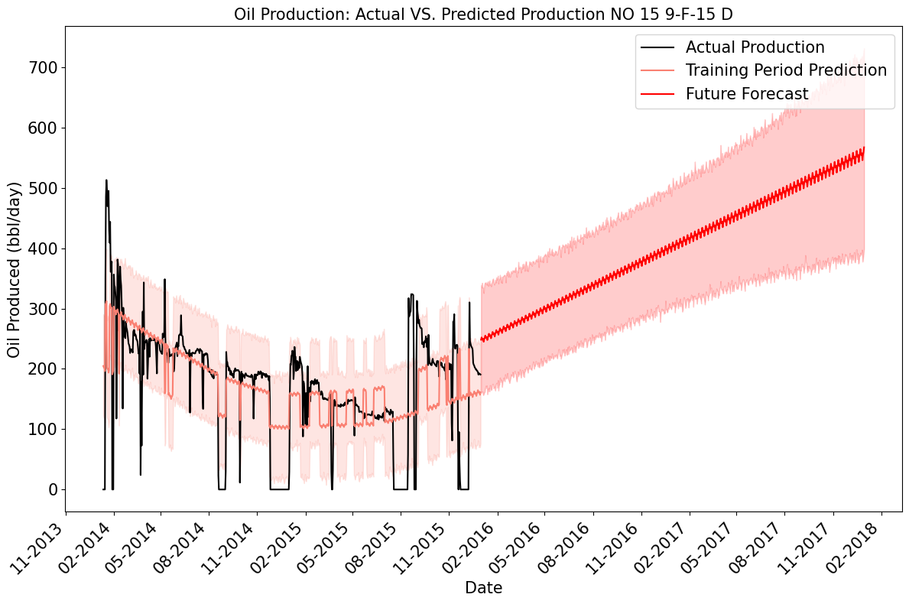
NO 15 9-F-15 D
Without data delete
With data delete

